Slide 1
HYCEAN
Mathew
Software engineer
Valdo Rabelais DjatsaKantsa
Student in Artificial Intelligence (AI)
Yogitaa Yogitaa
Master’s Student in Optics and Photonics
Angela Mareike Drust
Digital MSL
Winnie Uyen Nguyen
Optical Engineer

Slide 2
THE CHALLENGE
OCEAN GARDENS
Phytoplankton wellbeing is of existential importance to our whole interconnected ecosystems - including human survival. Not only does phytoplankton produce about 50% of the worlds oxygen¹, it also transforms and thereby binds carbon dioxide, nitrogen and silica, its biomass is also the ocean food chains starting point and its remains are carried ashore by the ocean winds to fertilize vast landscapes. Our oceans are at risk. This can be mitigated by fostering knowledge about Phytoplankton which may lead to loving admiration and the wish to safeguard phytoplankton and its major habitat - our oceans. Therefore we started to create an immersive experience accessible to everyone be it young or old showcasing the beauty and usefulness of Phytoplankton.
1 https://oceanservice.noaa.gov/facts/ocean-oxygen.html

Slide 3
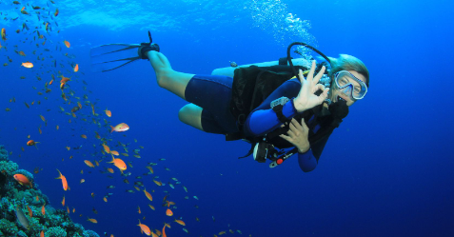
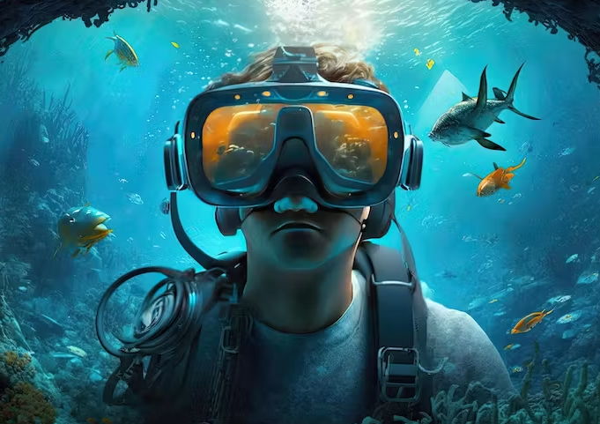
Immersive Phytoplankton Exploration
Dive into the ocean from home with VR.
Become a scuba diver avatar or an animal avatar powered by AI .
Encounter and explore various phytoplankton species.
Witness lifecycles and significance visually and sonically.
It’ll be an inclusive experience with sound files.
Personalized narration: facts modulated to match your voice.

Slide 4
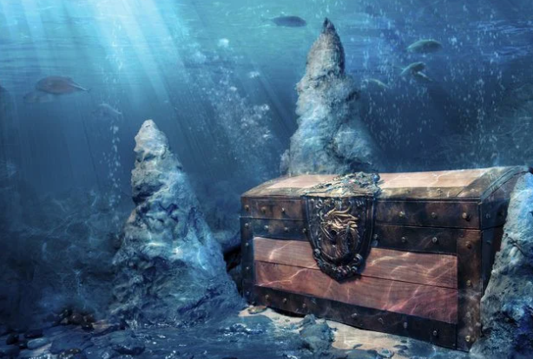
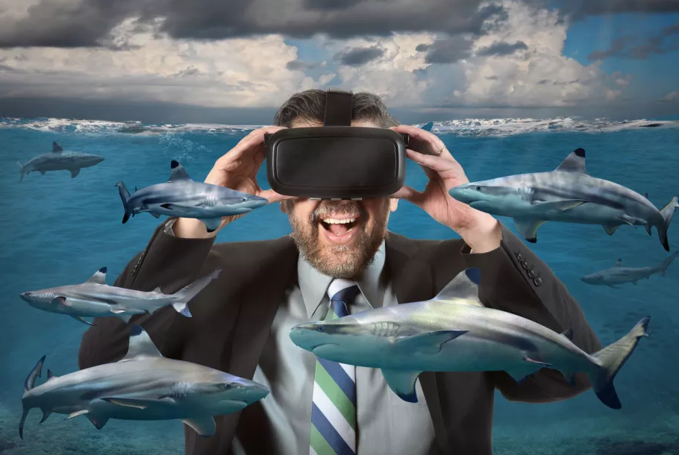
The Future of Oceanic Education
Introducing: "Treasure Hunt for Phytoplankton" game.
Team up, dive, and collect microscopic ocean marvels.
Transforming living rooms into oceanic adventure grounds.
A sneak peek into a vast world of educational possibilities.
Making ocean education an unforgettable journey.

Slide 5
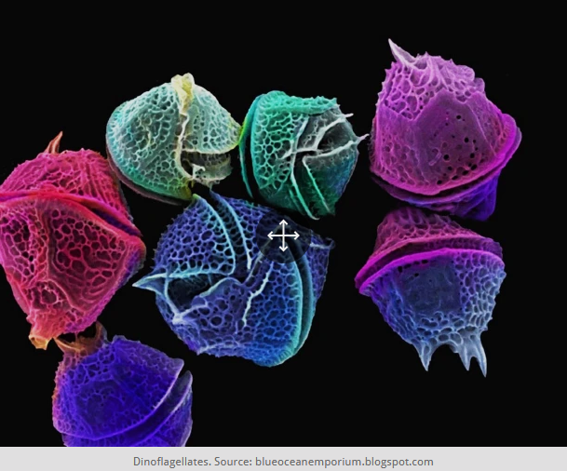
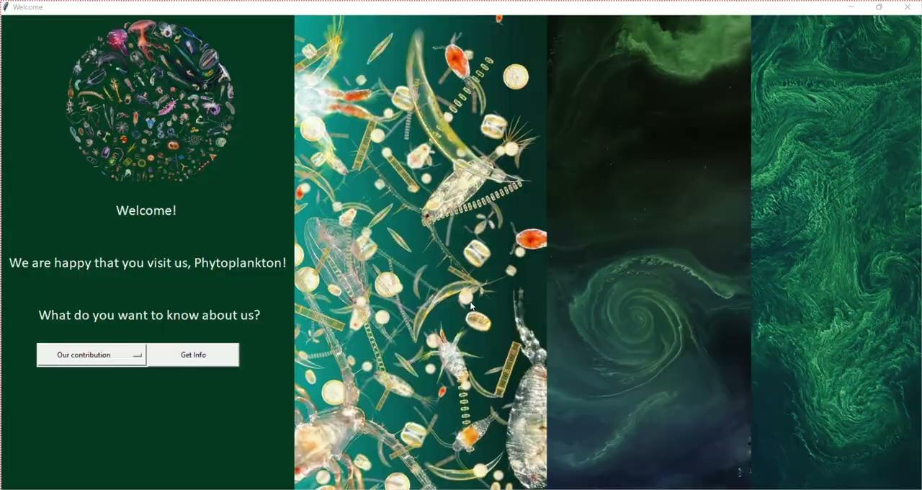
DEMO - user interface (UI)
https://github.com/winnie2112/OceanGarden_Hycean_NASASpaceApp2023

Slide 6
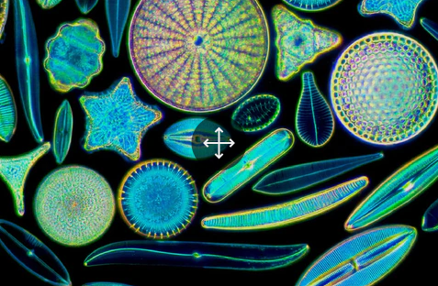
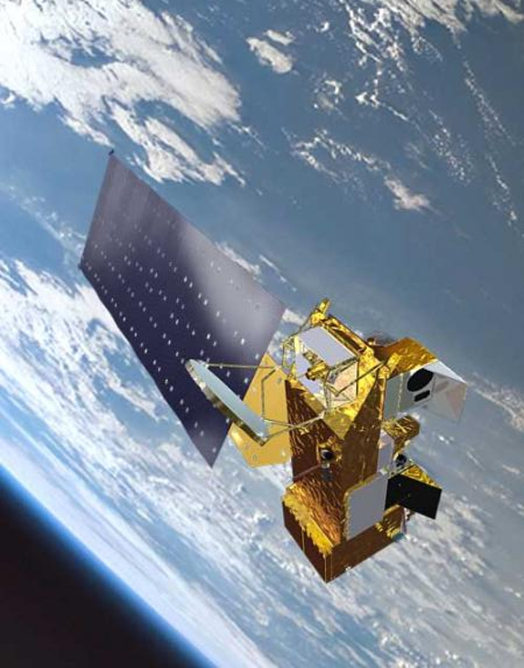
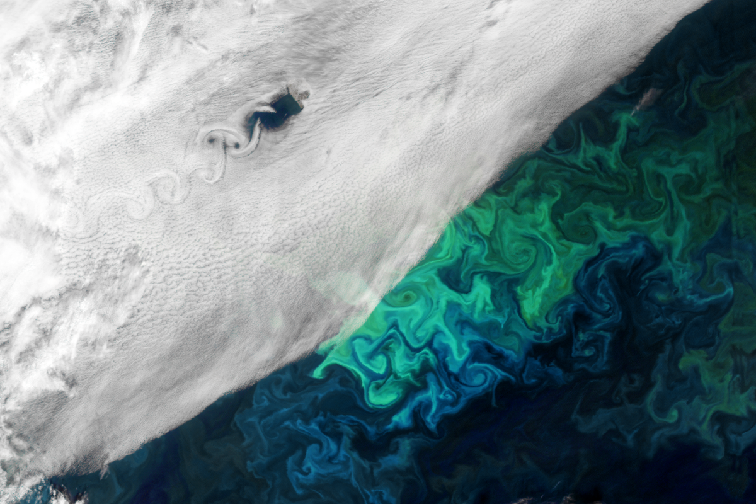
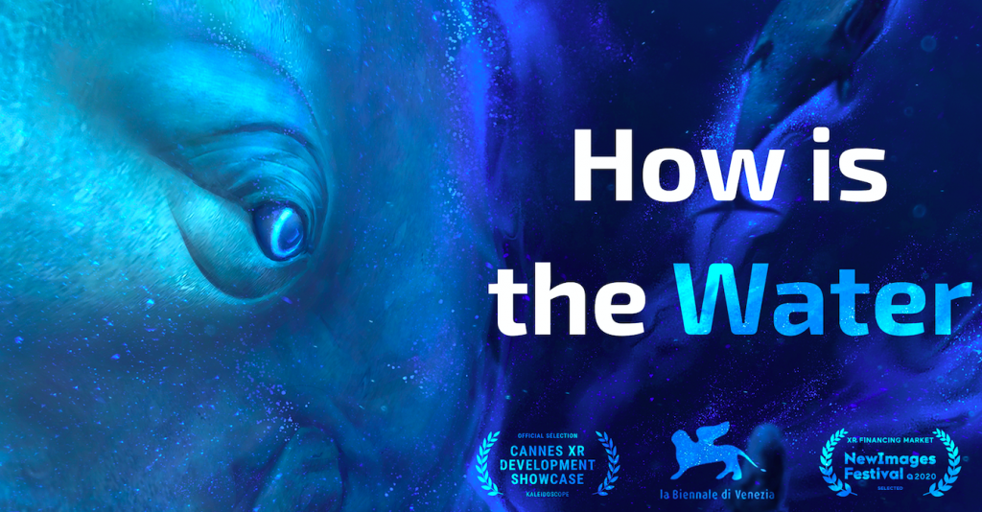
The RoAD AHEAD - DeMonsTRating THE IMPORTANCE OF PHYTOPLANKTON
From the Ocean to the Stars and back to Earth by Satellite:
Showcasing changes in the Phytoplankton world by using NASA satellite data,¹ to raise awareness for the interconnection between human action (e.g. greenhouse gas emission), environmental changes and the bumerang effects on human living conditions.
Developing coding techniques to generate an immersive user experience, adapting the web-based product to broadly available virtual reality tools, taking into account lessons learned from similar projects.^{3,4}
¹ https://oceancolor.gsfc.nasa.gov/data/overview/
² https://oceancolor.gsfc.nasa.gov/about/missions/aqua/
³ https://distantjob.com/blog/vr-programming/
⁴ https://en.reset.org/become-dolphin-and-learn-about-our-oceans-virtual-reality-07052021/

Slide 7
DEMO - WEBSITE
https://thenighthunte.github.io/The-Hackdown/
https://ocean-nasa.netlify.app/

